Slide 1
Webinar
February 22, 2024

Slide 2
Trevor Shaffer
Professional and Technical Services Manager at Redlist
LinkedIn:
https://www.linkedin.com/in/trevor-shaffer-413128b1/
Notes:
I was raised in a blue collar family, surrounded by farming and construction heavy equipment doing maintenance Myself. I was drawn to Redlist and I consider Myself lucky to have the privilege of working closely with several reliability and maintenance professionals over my last 8 years at Redlist. You folks are truly those who build the world! It has been an incredible journey to see how impactful technology can be when leveraged in ways that can give back what we all so desperately need, TIME and MONEY.

Slide 3
Overcoming the Three Biggest Obstacles in Setting Up a Lube Program

Slide 4
Three Biggest Challenges
Organizing and Sequencing Assets
Asset Identification
Ensuring Accuracy of Lube Management Tasks

Slide 5
Organizing and Sequencing Assets
Problem
Many facilities have asset lists that have been put together and maintained by a variety of different people throughout the years. Each of them with their own ideas as to how to number, identify, and name assets. Some facilities even struggle to agree on what should be considered an asset. This is a critical foundational piece and must be agreed upon and accurate before setting up a lube program
Solutions
Discuss and identify what items are assets and which items are components
Create clear asset hierarchies - Asset Groups in Redlist
-Location
-Building
-Line
Decide on a logical order for the assets
-This is used for sequencing routes when they are created
Notes:
A nation-wide wood, pulp & paper company knew that they needed to make a change. Their equipment failures were frequent and the maintenance team was burning the candle at both ends trying to keep things working on a 24/7 operation. Operators were hard to find with high turn-over, leading to poor operation and even more damage to equipment. The group got Redlist to drive inspections for all of their equipment and to also create a process to more easily report potential and urgent equipment issues to the whole team. The company decided that each facility would get set up and that by facility, all personnel from the Plant Manager, to the Plant Superintendent, to all supervisors, operators, mechanics, contractors, and safety personnel. The build their inspections in a way to notify the right people based on the issue that was identified, however, upper management was always notified of the issue. This extra visibility brought a lot more support for the team as they had more firepower have eyes on every issue that came through. People talked about the process more and they continued to refine. Items identified with operators were resolved and repairs started to not only decrease but turn-around got faster with the extra team support added.

Slide 6
Asset Identification
Problem
Many facilities either have insufficient tagging or identification of their assets throughout their facility or none at all. Without proper identification and tagging, lubricators cannot guarantee they are performing and completing all of the necessary lubrication tasks for an asset.
Solution
Redlist offers QR code and NFC tagging options with our Lubrication Program setup. These tags can be attached to the equipment, associated to an asset in an organized asset list, and then scanned to access the required and recommended lubrication tasks. Including the task frequency, product to use, and the volume of product to use.
Notes:
A nation-wide wood, pulp & paper company knew that they needed to make a change. Their equipment failures were frequent and the maintenance team was burning the candle at both ends trying to keep things working on a 24/7 operation. Operators were hard to find with high turn-over, leading to poor operation and even more damage to equipment. The group got Redlist to drive inspections for all of their equipment and to also create a process to more easily report potential and urgent equipment issues to the whole team. The company decided that each facility would get set up and that by facility, all personnel from the Plant Manager, to the Plant Superintendent, to all supervisors, operators, mechanics, contractors, and safety personnel. The build their inspections in a way to notify the right people based on the issue that was identified, however, upper management was always notified of the issue. This extra visibility brought a lot more support for the team as they had more firepower have eyes on every issue that came through. People talked about the process more and they continued to refine. Items identified with operators were resolved and repairs started to not only decrease but turn-around got faster with the extra team support added.

Slide 7
Lubrication Task Accuracy
Problem
Few facilities have accurate lubrication task information included in their current work order systems. What we typically see from legacy systems are work orders that say, "Lubricate "X" asset" or "Perform Lubrication on Line 1" without any further instruction. This leads to confusion, missed lubrication tasks, and ultimately equipment failures related to lubrication issues.
At Redlist, we tackle this problem with two different solutions
Remote Onboarding Assistance
Our remote team can go through equipment manuals to pull out all of the manufacturers recommended lubrication tasks.
Onsite Lubrication Audit
We have teams that visit our customers facilities and audit the equipment to make sure all prioritized assets, components, and task information has been properly captured and
recorded.
Notes:
A nation-wide wood, pulp & paper company knew that they needed to make a change. Their equipment failures were frequent and the maintenance team was burning the candle at both ends trying to keep things working on a 24/7 operation. Operators were hard to find with high turn-over, leading to poor operation and even more damage to equipment. The group got Redlist to drive inspections for all of their equipment and to also create a process to more easily report potential and urgent equipment issues to the whole team. The company decided that each facility would get set up and that by facility, all personnel from the Plant Manager, to the Plant Superintendent, to all supervisors, operators, mechanics, contractors, and safety personnel. The build their inspections in a way to notify the right people based on the issue that was identified, however, upper management was always notified of the issue. This extra visibility brought a lot more support for the team as they had more firepower have eyes on every issue that came through. People talked about the process more and they continued to refine. Items identified with operators were resolved and repairs started to not only decrease but turn-around got faster with the extra team support added.

Slide 8
Demo
Conclusion
Lubrication Programs are a critical piece in properly maintaining the assets at a facility. However, if these programs are not set up correctly and accurately, they won't provide the desired result of limiting downtime caused by lubrication-related equipment failures.
Notes:
webinar@getredlist.com is username

Slide 9
Questions?
Notes:
webinar@getredlist.com is username

Slide 10
Thank You

Slide 11
Basic Graphics & Icons

Slide 12
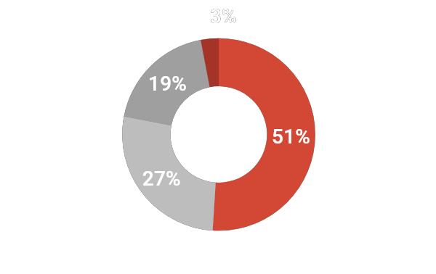
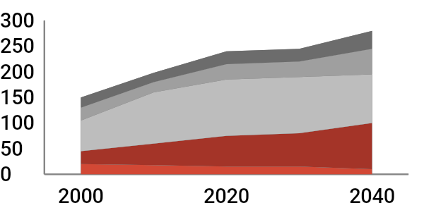
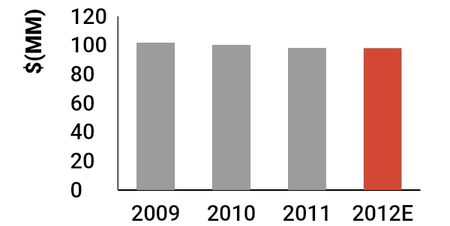
REDLIST color palette – charts and graphs
Charts and graphs colors
White
Black
Grey
Red
Blue
Cyan
Green
Lime
Yellow
Orange
Primary colors
Accent colors
Examples
Use color to callout a specific data point as needed

